Slide 1
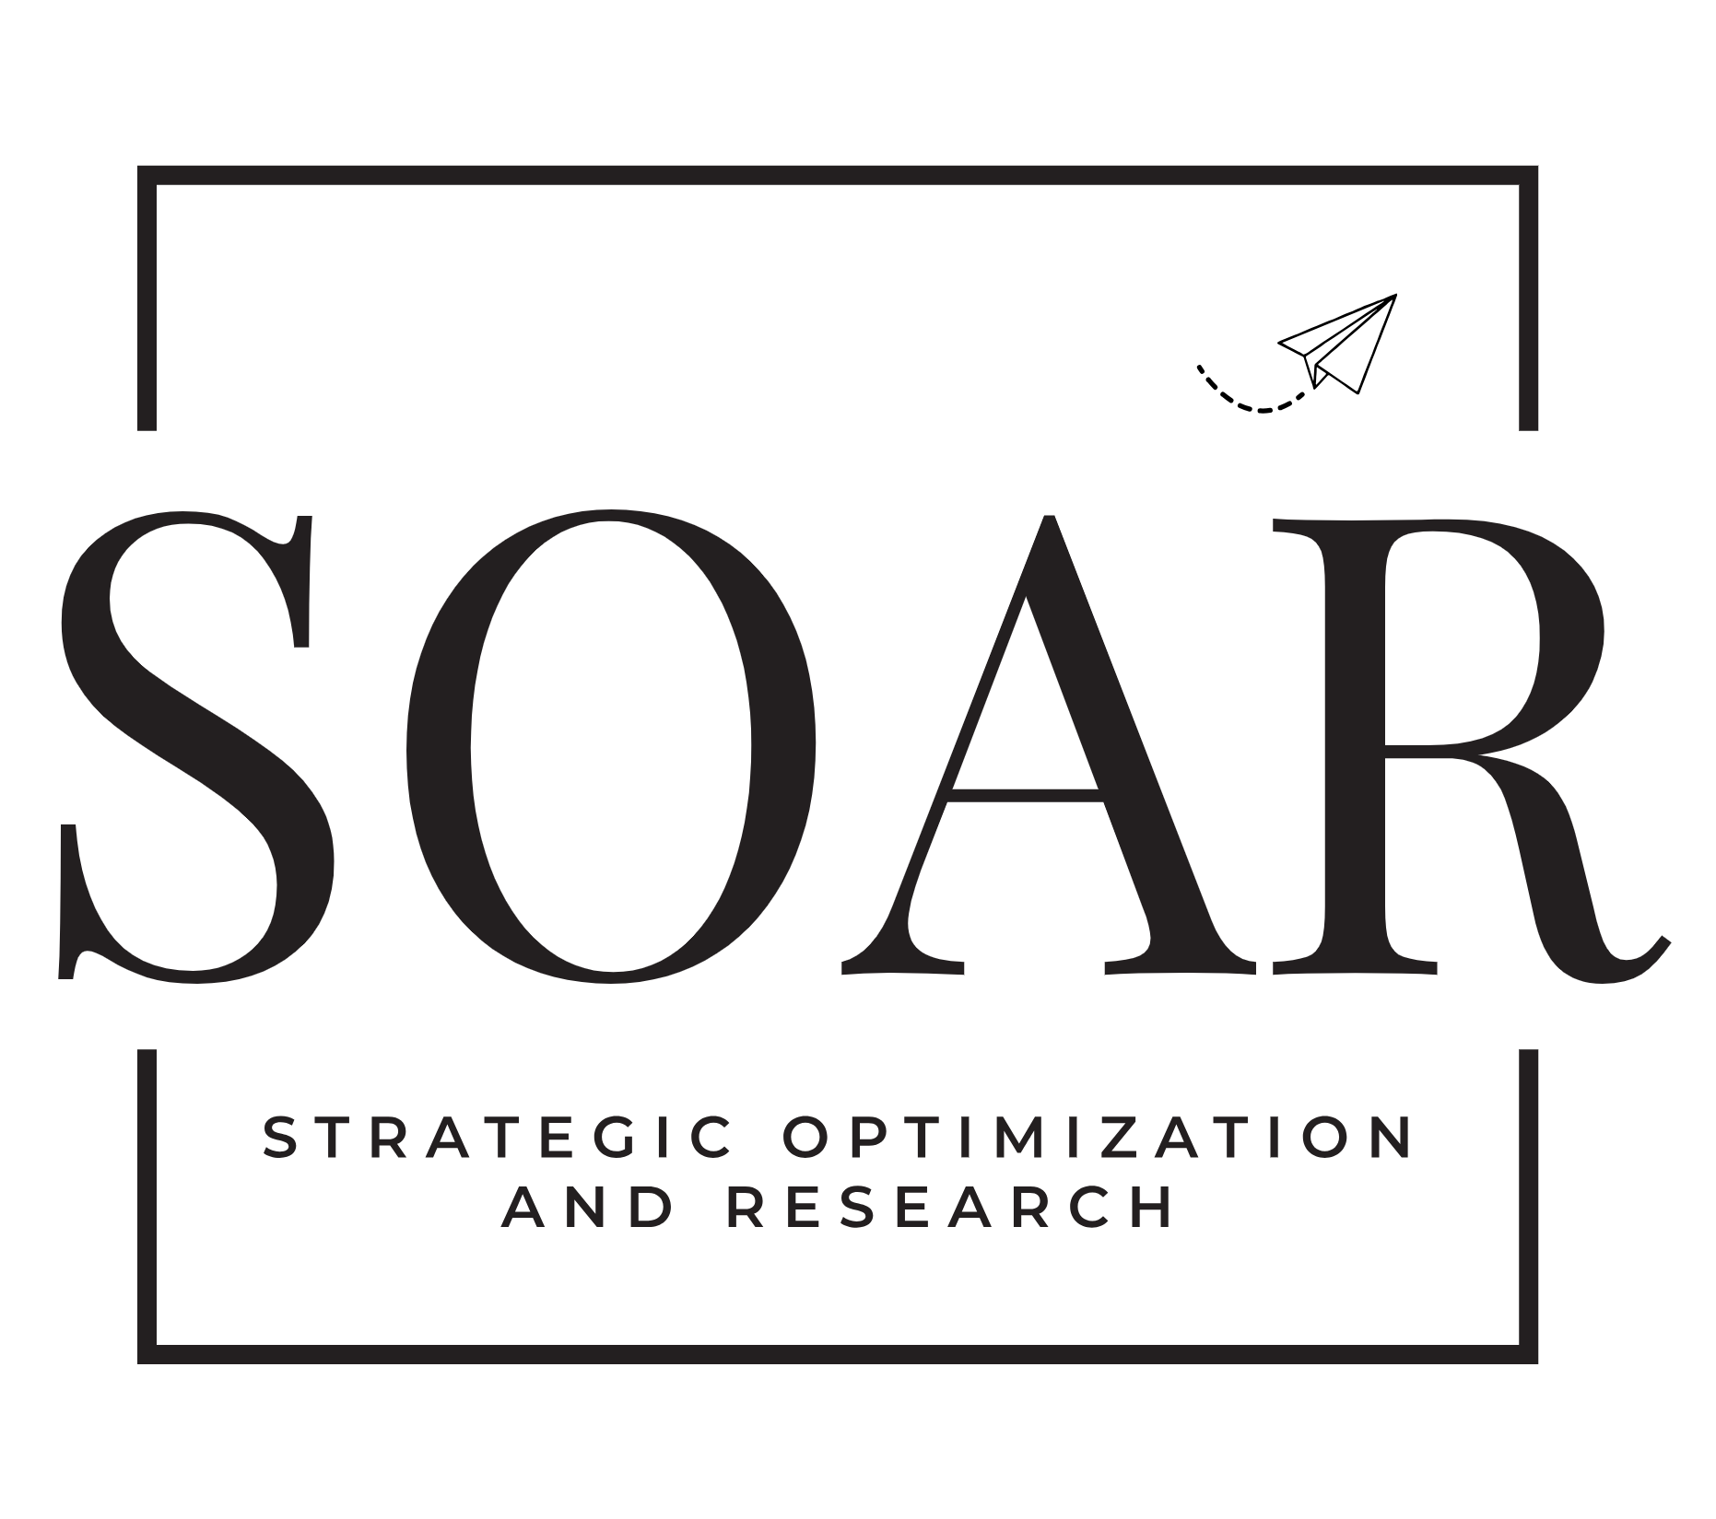
Success Strategies for Leaders based on Stephen Covey’s Book
The 7 Habits of Highly Effective People
February 3, 2025
By: Joanne Gallagher, PMP, HCS
Joanne@SOAR.llc

Slide 2
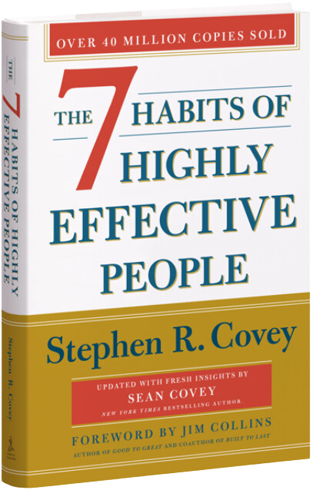
Predicated on the bestseller:
Unveiling the 7 Habits of Highly Effective People

Slide 3
Let’s Get Tactical: The 7 Habits in Summary
Habit 1: Be Proactive
Habit 2: Begin with the End in Mind
Habit 3: Put First Things First
Habit 4: Think Win/Win
Habit 5: Seek First to Understand, Then to be Understood
Habit 6: Synergize
Habit 7: Renewal
Private Victories
These habits are personal and only you can see them.
Public Victories
These are habits are on display for all to see.
Renewal
These are habits are interdependent

Slide 4
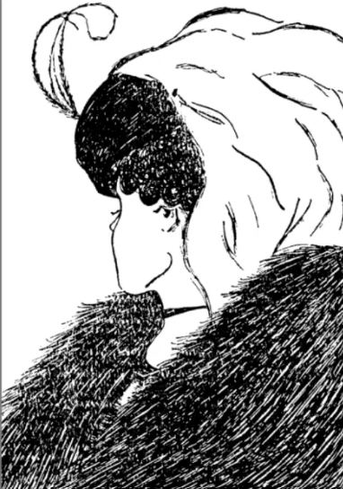
The Old Woman Young Woman Illusion is a perceptual phenomenon that has fascinated people for generations. It’s a classic optical illusion that, depending on your perspective, reveals either the image of a young woman or an elderly woman.

Slide 5
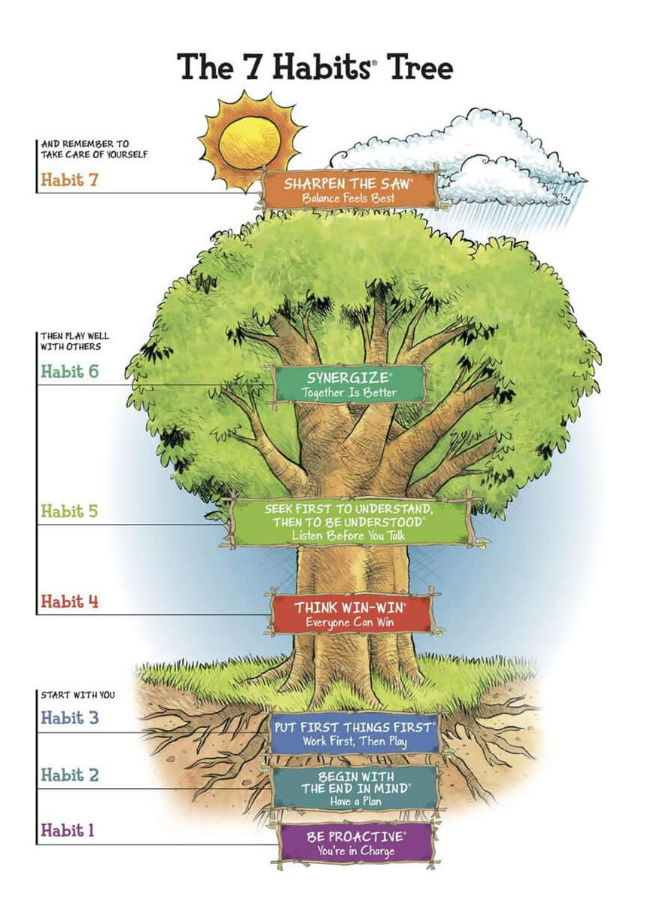

Slide 6
Inside – Out
Starts with you
Principles are natural law like honesty, fairness, respect, integrity, etc.
P/PC Balance
P – Production of desired result
PC – Production Capability, the ability to continue to produce
Paradigm shifts: changing the lens through which you view

Slide 7
What is a “Principle-Centered Leader”?
Principle-centered leadership is practiced from the inside out and on four levels. We need to utilize the four principles (security, guidance, wisdom, power) along these four levels (personal, interpersonal, managerial, and organizational).
In Principle-Centered Leadership, you may find answers to some of the problematic questions that arise at home and at work:
How do we achieve and maintain a wise and renewing balance between work and family?
How can we be empowered (and empower other people) with confidence and competence to solve problems and seize opportunities?
How do we unleash the creativity, resourcefulness, talent, and energy of the vast majority of the present work force?
How do we turn a mission statement into a constitution?
Personal
Interpersonal
Managerial
Organizational

Slide 8
Characteristics of a Principle-Centered Leaders
They are continually learning
They are service-oriented
They radiate positive energy
They believe in other people
They lead balanced lives
They see life as an adventure
They are synergistic
They exercise for self-renewal

Slide 9
A Brief Overview of the 7 Habits of Highly Effective People… …and Leadership Implications

Slide 10
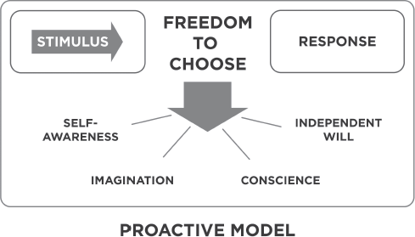
Habit 1: Be Proactive
Proactive people are driven by values and reactive people are driven by feelings, conditions, circumstances, environment.
Proactive: Not merely taking initiative, but human beings are responsible for their own lives.
Our behavior is a function of our decisions, not our conditions. We can subordinate our feelings to our values.
“Response-able”: Don’t let forces out of your control how you decide to move forward.
Reactive people are affected by their environment (physical, social, etc.). They empower those forces to have control.
Text

Slide 11
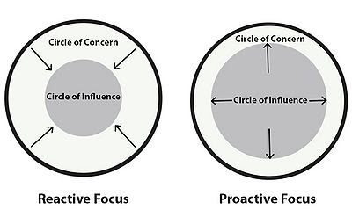
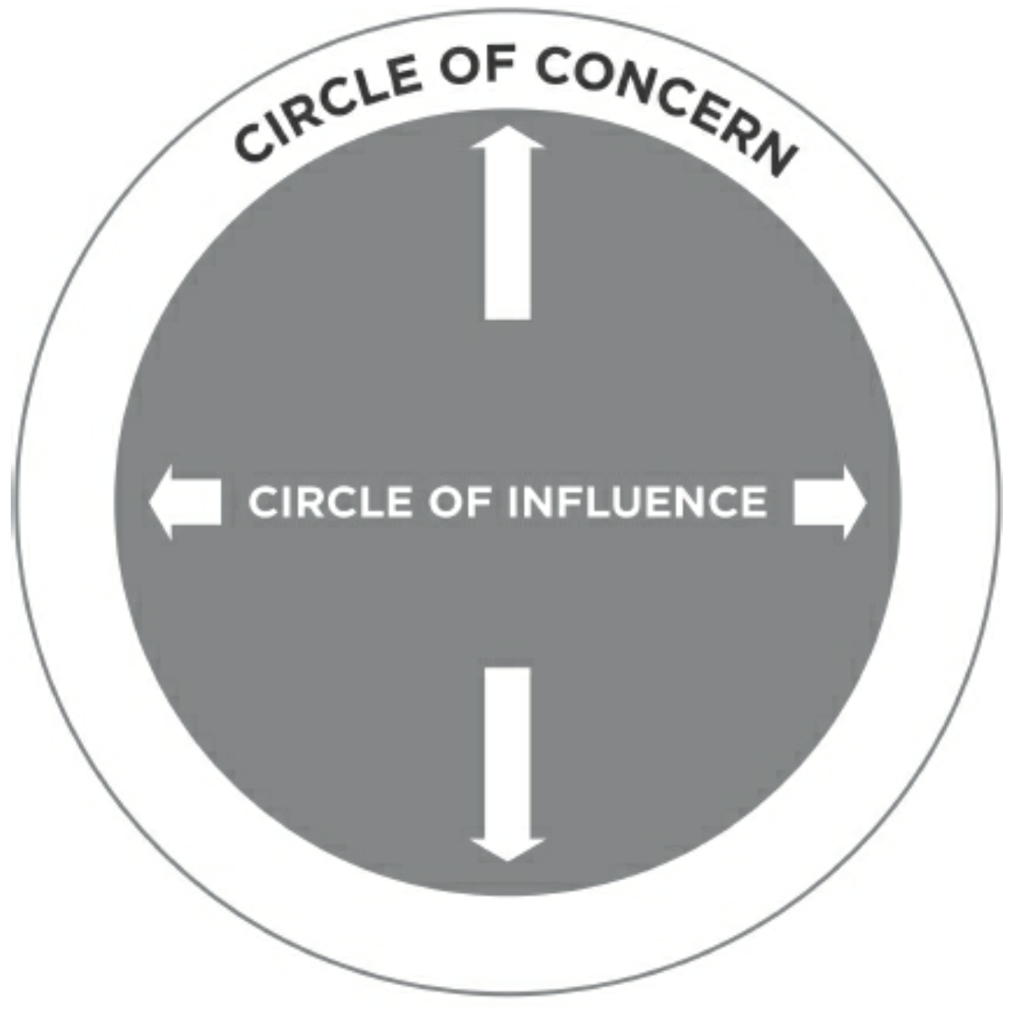
Habit 1: Be Proactive (cont’d) Control: Direct, Indirect, No Control

Slide 12
Leaders! Heed Habit 1 – Be Proactive
You can choose your response to any situation
The more you exercise your freedom the bigger it will become
As you work in your circle of influence you will stop being a ‘hot reactor’ and start being a ‘cool, responsive chooser’
Proactivity cultivates this freedom. It subordinates your feelings to your values”
- Stephen Covey

Slide 13
Habit 2: Begin with the End in Mind
Based on the principle that all things are created twice:
Before you build a the you have blueprints made before the earth is touched; before you cook a recipe, you make a list of ingredients and steps before a single measurement is made;

Slide 14
Leaders! Heed Habit 2 – Begin with the End in Mind
“Within my circle of influence, I will decide; I have the power to choose”
Man’s Search for Meaning; Viktor Frankl
Only people have the capability to imagine, envision and engineer
See yourself using your imagination and conscience
Memory is built on past responses to the same or similar stimuli. Imagination points you to your future
FUTILITY
CONTINUUM
HOPE/PURPOSE

Slide 15
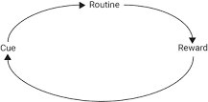
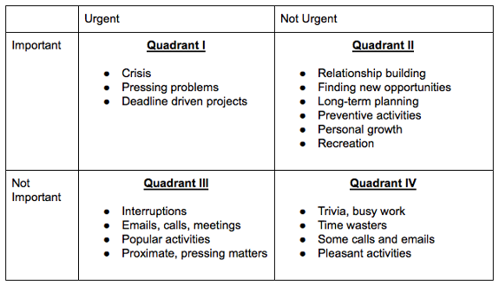
Habit 3: Put First Things First
Put First Things First is about protecting time for what's most important to us. Habit 1 focuses our effort on what we can influence. Habit 2 aims us in the right direction. Habit 3 is the day in, day out, moment-by-moment work that takes us to that vision.
"The key is not to prioritize what's on your schedule, but to schedule your priorities."

Slide 16
Leaders! Heed Habit 3 – Put First Things First
As you move from victim to creative resource, from futility to hope and anchorage and from flaky to disciplined, Habits 1, 2, and 3 will draw on your:
Self awareness/Self knowledge
Conscience and imagination
Willpower
DRIVEN BY CRISIS
“CAN’T/WON’T”
CONTINUUM
FOCUS ON THE IMPORTANT, NOT NECESSARILY URGENT – USE YOUR WILLPOWER TO RECOGNIZE

Slide 17
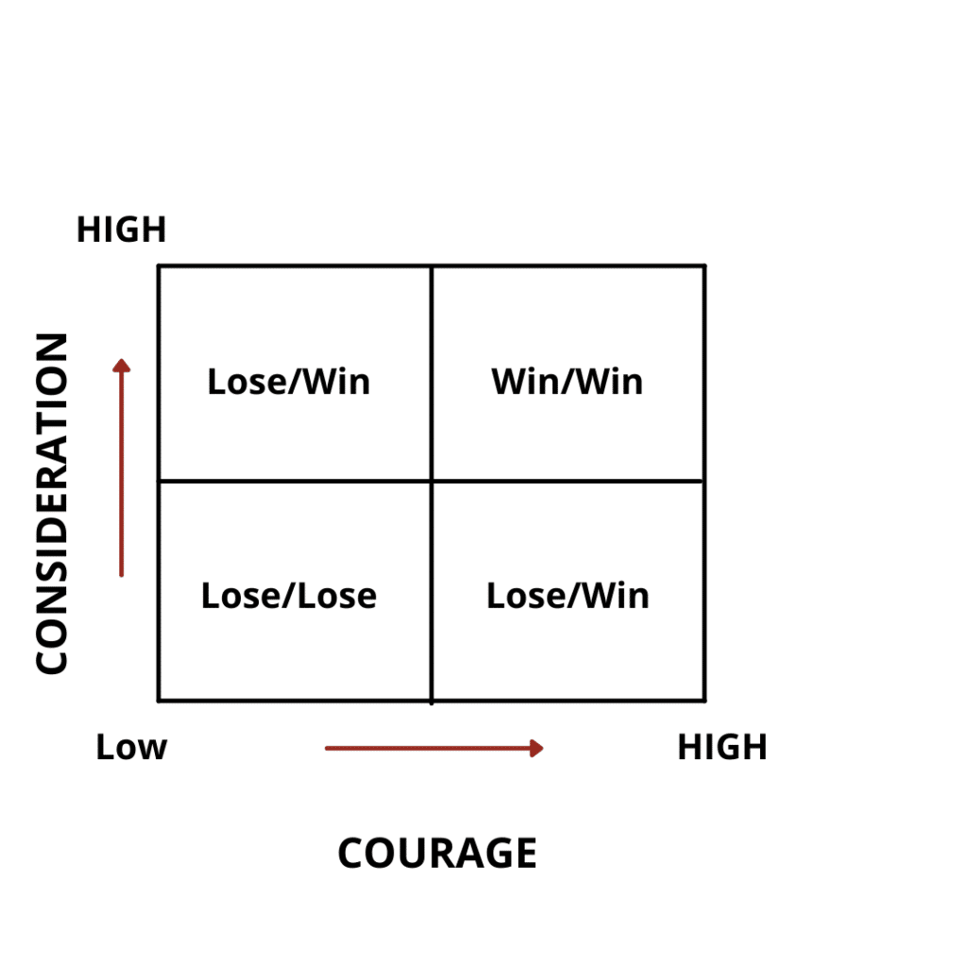
Habit 4: Think Win - Win
Win-win is about constantly seeking mutual benefit in all human interactions—about finding solutions that are truly beneficial and satisfying for everyone involved. To go for win-win, we not only have to be empathic, but we also have to be confident.
Five interdependent dimensions of life contribute to effective interpersonal leadership that is Win/Win: 1) Character, 2) Relationships, 3) Agreements, 4) Systems, and 5) Process. Character is the foundation of Win/Win and characterized by integrity, maturity, and an abundance mentality.

Slide 18
Leaders! Heed Habit 4– Think Win/Win
Endowment of an abundance mentality
Security comes from principles
As people become more people-centered, they love to share recognition and power
They understand it is not a limited pie
The great capabilities of people are hardly ever tapped
The abundance mentality produces more profit, power and recognition for everybody
SCARCITY MINDSET
CONTINUUM
INTRINSIC SELF-WORTH
BENEVOLENT DESIRE FOR MUTUAL BENEFIT

Slide 19
Habit 5: Seek First to Understand, Then to Be Understood
Habit 5: Seek First to Understand, Then To Be Understood is about listening before we speak. Our default tendency is to try to get our point across. In doing so, we may ignore the other person completely, pretend that we're listening, or focus on the words and miss the meaning.
The least effective is to just listen to what is being said and then repeat them
The second is to rephrase what is being said to us.
Now we start paying attention to how they feel about what they are saying.
Ask non-judgmental questions that seek out the nuances of someone's perspective or experience. Listen to understand, not to respond. Speak from experience, not of experience. Speak from the “I” (versus the “you,” “they” or “we”).

Slide 20
Leaders! Heed Habit 5– Seek First to Understand, Then be Understood
Are you preparing your reply when someone else is talking?
When you truly listen, the whole relationship is transformed
People do not listen with empathy. They listed from within their autobiography
- Stephen Covey

Slide 21
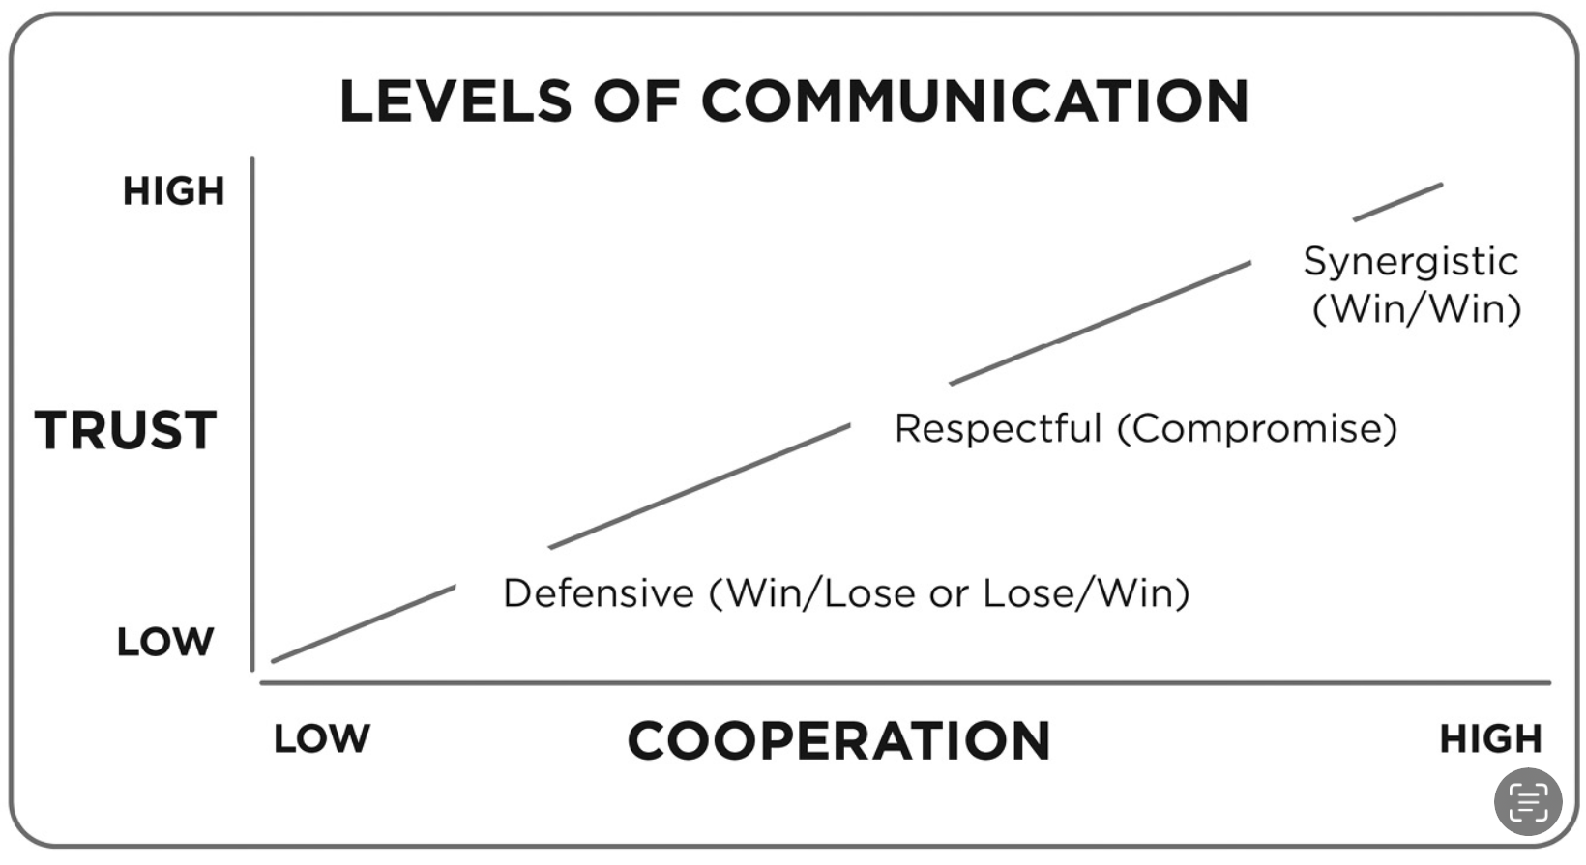
Habit 6: Synergize
Habit 6: Synergize is about working together to find new solutions to challenging problems. Synergy is when the sum is greater than its parts. It's often expressed as an equation where 1 + 1 = 3, 10, or 1,000.
They must have similar goals.
They have a sense of self.
They stay open to new ideas.
They embrace trust.
They should understand that the best to do things is by working together.
They show respect to each other.
They must have the courage to apologize.

Slide 22
Leaders! Heed Habit 6– Synergize
This habit is the endowment of creativity
Most important commitment to business:
Never badmouth - be loyal to people who are absent to gain trust with those who are present
When you get into synergetic communication, you leave position. You understand basic underlying needs and interests and find solutions to satisfy them both

Slide 23
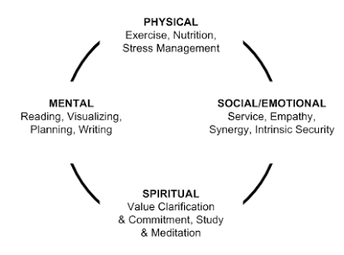
Habit 7: Sharpen the Saw
Dull or rusty tools are much less effective than clean and sharp tools. The same is true for us. This habit is about preserving and enhancing the greatest asset we have to deal with life and contribute—ourselves. It’s about balancing the four dimensions of body, heart, mind, and spirit.
To achieve balance in our self-care means taking the necessary time to renew each of the four human dimensions.
Body: Exercising, eating well, getting enough sleep
Heart: Investing in our relationships
Mind: Growing our knowledge and skill
Spirit: Spending time on activities that align with our deepest values

Slide 24
Leaders! Heed Habit 7– Sharpen the Saw
This is the unique endowment of continuous improvement or self renewar to overcome entropy.
If you do not improve and renew yourself constantly, you'll fall into closed systems and styles.
ENTROPY
- WILL BREAK DOWN
CONTINUUM
IMPROVEMENT, INNOVATION, REFINEMENT

Slide 25
Open Discussion

Slide 26
Interested in more training opportunities?
Contact us. We would love to hear from you!
Please reach out through one of the following methods:
(850)566-1235
Email: contact@soar.llc
joanne@soar.llc
www.soar.llc
850-566-1235

